Slide 1

Navigating Germany's Booming Tech Job Market in 2025
Germany leads Europe's tech economy with a €129B IT sector. The market shows exceptional growth with over 770,000 tech vacancies nationwide.
Let's explore five leading German tech companies and their unique career opportunities.

Slide 2






Meet the Giants: Four Key German Tech Companies
SAP
Siemens
Bosch
Global ERP leader headquartered in Walldorf with 100,000+ employees worldwide
Digital industry pioneer specializing in automation and industrial technology
Automotive and IoT innovator employing 421,000 specialists globally
Deutsche Telekom
InnoGames
Europe's telecom giant leading 5G implementation and AI integration
The German mobile games company InnoGames' Forge of Empires has officially surpassed €1 billion.

Slide 3
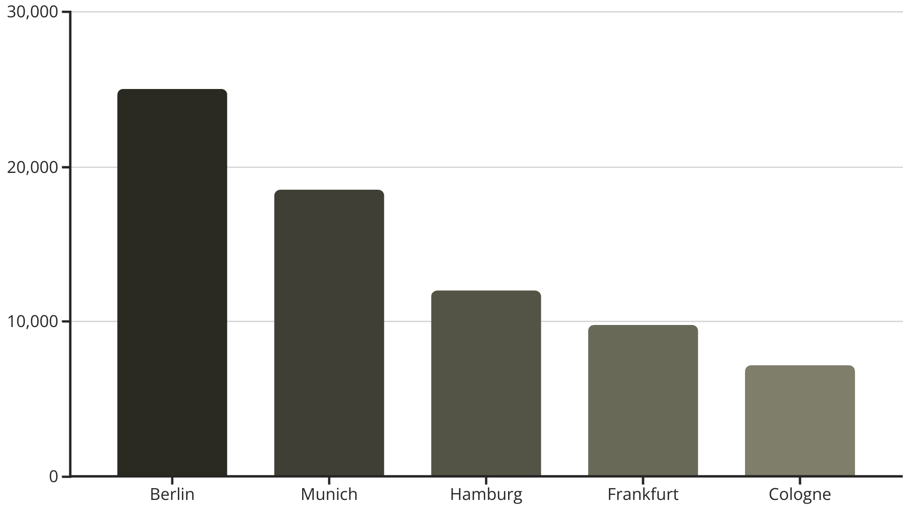
The Data: Where Opportunity Awaits
Jobs Available
German Cities

Slide 4

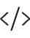



Top In-Demand Roles and Salaries
Software Developer
Entry level starting at €43,000+ with rapid growth potential within 2-3 years
Cybersecurity Specialist
Median salary of €63,000 with critical shortage of qualified professionals
AI/Machine Learning Engineer
Positions increased 3.9x since 2022, commanding premium salaries
Cloud Architect
Among fastest-growing roles alongside Data Scientists and Digital Health specialists

Slide 5






Skills That Open Doors
Specialized Credentials
AI/ML and cybersecurity certifications
Technical Skills
Python, Java, C++, AWS, cloud computing
German Language
Strongly preferred for most positions
Companies increasingly value soft skills. Communication and teamwork often make the difference in hiring decisions.

Slide 6

Employer Snapshots & Example Job Ads
Company
Role
Location
SAP
Data Scientist
Walldorf, Berlin
Siemens
Industrial Software Engineer
Munich
Celonis
Machine Learning Engineer
Munich (hybrid)
Deutsche Telekom
Cybersecurity Analyst
Bonn
Bosch
Embedded Systems Developer
Stuttgart
Most roles offer flexible working arrangements. Remote and hybrid positions increased by 45% since 2023.

Slide 7








Visualization: Candidate Profiles vs. Job Requirements
Technical Skills
Language Proficiency
Programming languages, frameworks, tools
German and English levels
Experience
Education
Years and relevance to position
Relevant degrees and certifications
Junior roles prioritize technical skills. Senior positions emphasize German language and domain expertise.

Slide 8





Your Step-by-Step Success Guide
Network Strategically
Join LinkedIn, and attend local tech meetups and conferences
Adapt Your CV
Follow German standards with skills-focused content and formal structure
Target Growth Sectors
Focus on AI, sustainability, digital health, and fintech opportunities
Start Small If Needed
Consider internships or freelance work to build local experience
Success comes from persistence. The German tech market rewards systematic approaches and continuous learning.

